Slide 1

PROJECT ON CAREER TRENDS EXPLORER AND PERSONALIZED JOB MATCHER
NAME: S. SUJANA KUMARI AFFILIATION: DIGICROME ACADEMY

Slide 2
PROJECT OVERVIEW
Objective:
The project aims to provide a deep understanding of workforce trends and deliver a personalized job recommendation system. By analyzing job market data, the platform will identify high-demand roles, uncover salary patterns, highlight emerging job categories, and provide job seekers with tailored opportunities that align with their preferences and market needs.
Situational Overview:
The job market is dynamic, influenced by technological disruptions, economic cycles, and evolving work preferences such as remote jobs. This project will leverage advanced data analytics and predictive modeling to uncover valuable insights, empowering both job seekers and recruiters to make informed, strategic decisions. By combining historical and live job posting data, the platform will act as a one-stop tool for career trends exploration and personalized job recommendations.

Slide 3
DATA DESCRIPTION
SOURCE OF MOBILE DATA: The data used for the analysis is provided by Next Hikes.
FEATURES/VARIABLES INCLUDED: There are around 7 features and variables included in the data. The most common and important variables include title, published date, hourly pay, budget, country .
DATA SIZE AND FORMAT: The dataset includes store-specific details, promotions, holidays, customer count, and competitor information, all crucial for forecasting sales.
NECESSARY LIBRARIES TO BE IMPORTED:
Jupyter notebook and VS Code.
Technical Skills: Pandas, Matplotlib, Numpy, HTML and CSS ,
Stremlit.

Slide 4
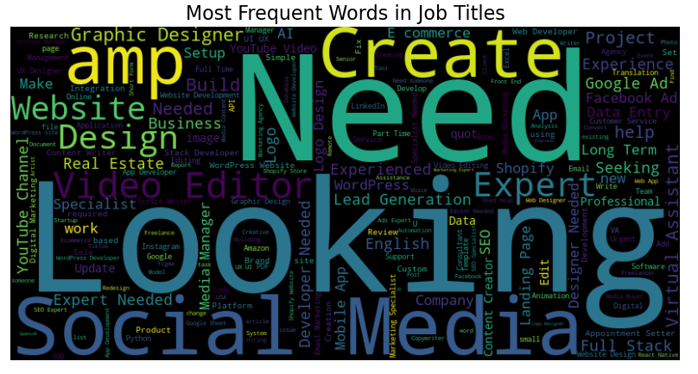
DATA VISUALIZATION
WORD CLOUD OF MOST FREQUENT WORDS IN JOB TITLE
This word cloud provides a quick and visually appealing overview of the most common terms used in job titles. It can be a valuable tool for understanding general job market trends and popular skills, but it should be complemented with more detailed research for specific job roles and industries.

Slide 5
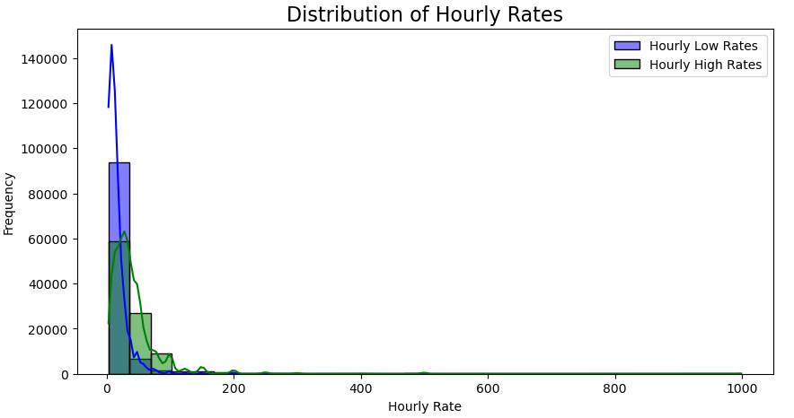
DATA VISUALIZATION
2. Distribution of Hourly rates
Business or Analytical Implications:
Majority of Workforce Earns Low Wages: Policies or skill improvement programs could focus on helping workers move into higher-paying jobs.
High-Paying Jobs are Rare: Industries or roles that command high rates should be explored for better career recommendations.
Potential Salary Cap Considerations: Companies may need to re-evaluate pay structures to ensure fair distribution of wages.

Slide 6
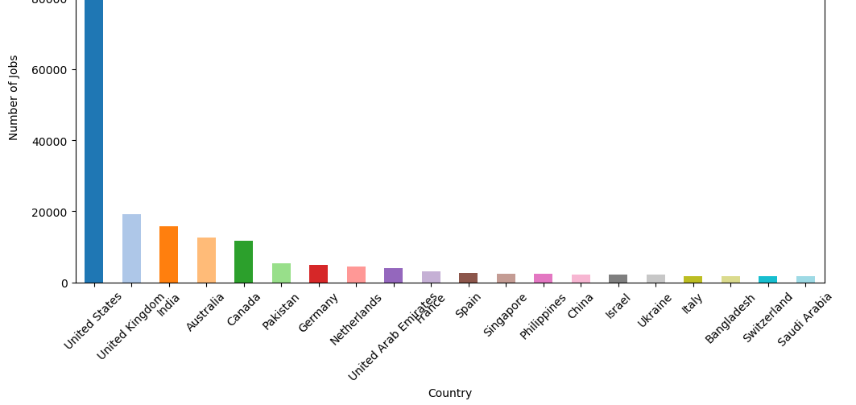
DATA VISUALIZATION
3. Top 20 Countries by Job Postings
Impressions and Insights:
The data could be influenced by job platforms focusing more on English-speaking countries.
The demand for remote work and freelancing could be contributing to job postings in countries like Pakistan and the Philippines.
The United States' dominance may indicate a strong economy, high labor demand, and significant online job postings.

Slide 7
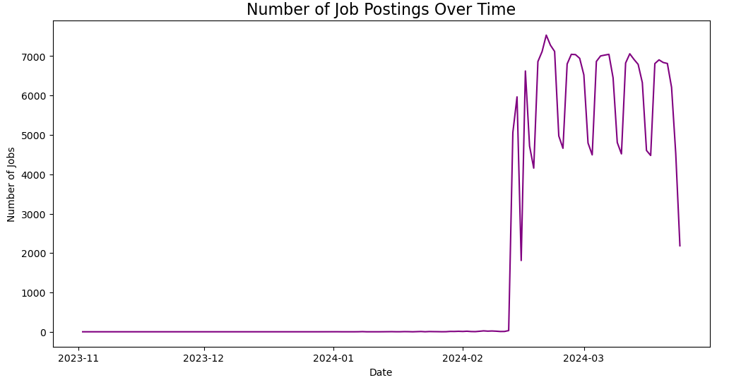
DATA VISUALIZATION
4. Number of Job Postings Over time
INTERPRETATIONS:
The early February jump might indicate when the platform started tracking job postings.
The cyclic nature suggests companies might be posting in batches, possibly following hiring trends such as end-of-month or start-of-week job openings.
Some industries (e.g., tech, retail) have seasonal hiring trends that could explain the fluctuations.

Slide 8
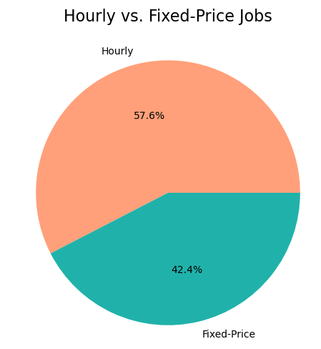
DATA VISUALIZATION
5. Hourly Vs. Fixed Price Jobs
INTERPRETATION:
While both payment models are widely used, hourly jobs dominate the market slightly, showing a trend toward flexible work arrangements. However, fixed-price jobs remain a substantial portion, appealing to those who prefer structured, results-based compensation.

Slide 9
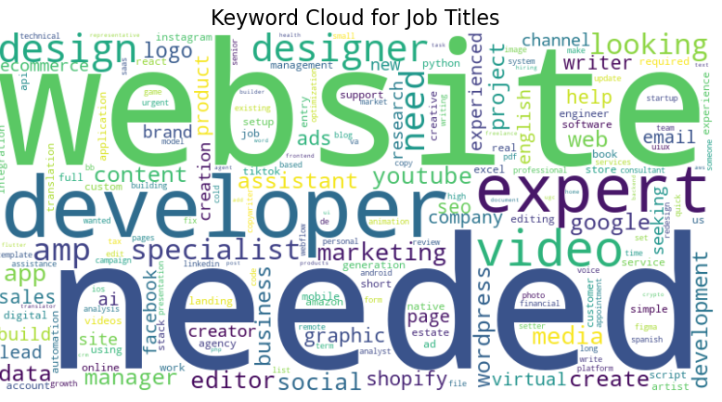
DATA VISUALIZATION
6. Key word cloud for Job Titles
INTERPRETATION:
In summary, this keyword cloud provides a visual overview of popular terms used in job titles, highlighting trends in tech, digital marketing, and general job roles. It's a helpful starting point for understanding job market trends but should be used with additional research for a deeper understanding.

Slide 10
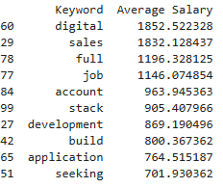
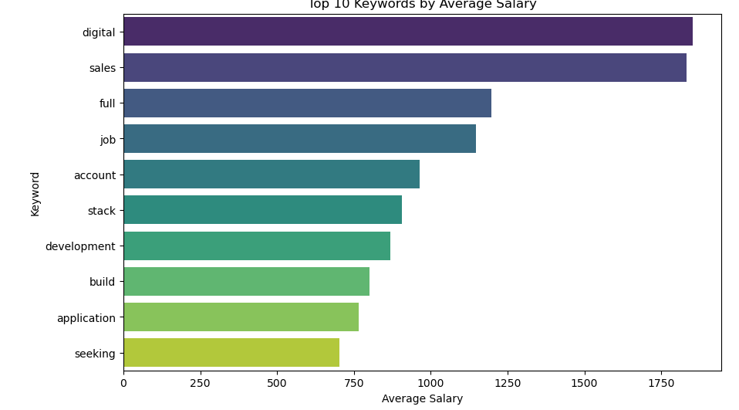
TASK 1 – ANALYZING KEYWORDS AND SALARIES
1. Keywords with average salaries.
Conclusion
The chart suggests that digital, sales, and software-related jobs are among the highest-paying roles. Individuals looking to maximize earning potential should consider gaining expertise in digital transformation, sales, full-stack development, and application development.

Slide 11
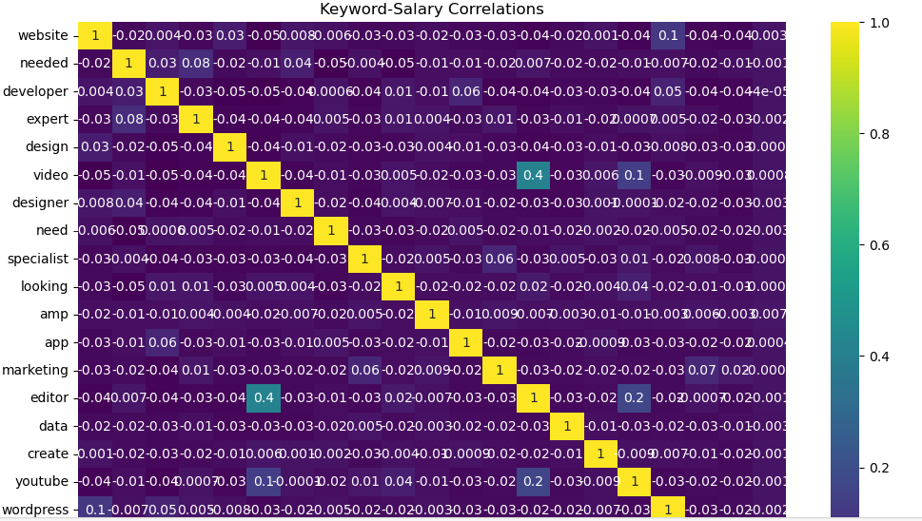
TASK 1 – ANALYZING KEYWORDS AND SALARIES
1. Keywords salaries correlation.
Specific Observations:
Positive Correlations: Keywords like "developer," "expert," "specialist," "marketing," and "editor" show strong positive correlations with salary. This suggests that roles involving these skills or expertise are likely to command higher compensation. "Video," "designer," and "youtube" also exhibit moderate positive correlations, indicating that these areas might contribute to higher salaries but to a lesser extent.
Negative Correlations: "Needed" and "looking" show negative correlations. This might indicate that these terms are more prevalent in job postings with lower salary ranges. Neutral Correlations:
Many keywords like "design," "create," "wordpress," and "app" have correlation coefficients close to zero, suggesting a weak or no relationship with salary.

Slide 12
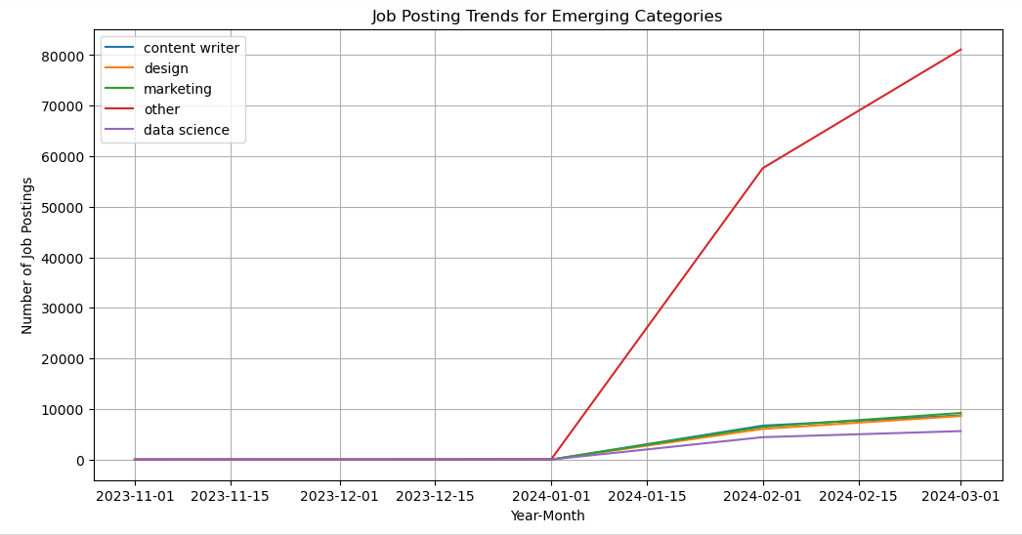
TASK 2 – IDENTIFYING EMERGING JOB CATEGORIES
Job posting trends for emerging categories
INTERPRETATION:
The graph illustrates a positive outlook for job seekers in emerging categories like data science, design, and marketing. The increasing demand for professionals in these fields suggests promising career opportunities in the coming months.

Slide 13
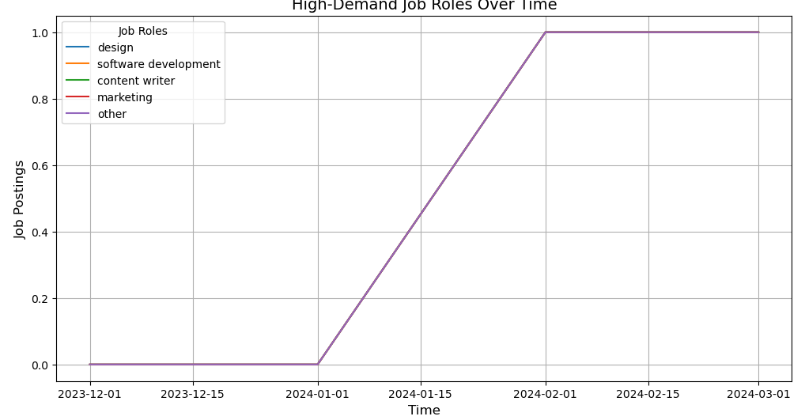
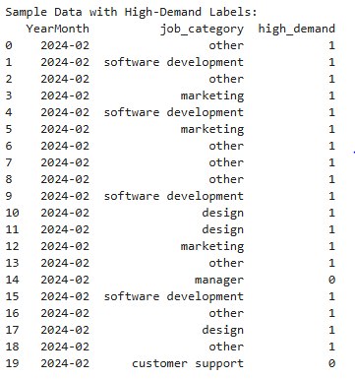
TASK 3 – HIGH DEMAND JOB ROLES PREDICTION
High demand job roles overtime
In Summary:
The line graph reveals a significant increase in demand for various job roles, particularly "Other" and Software Development, from February 2024 onwards. This suggests a dynamic job market with emerging opportunities in diverse fields.

Slide 14
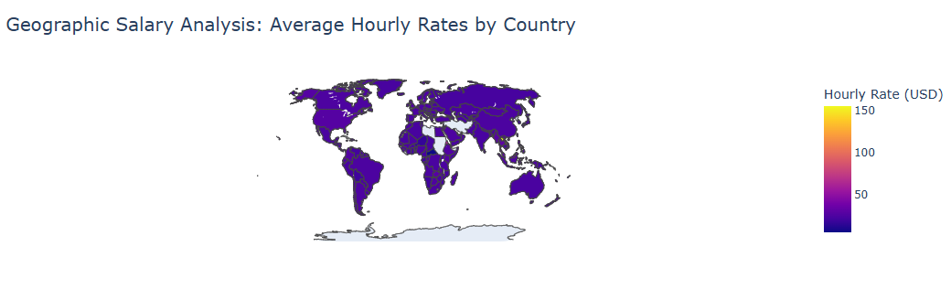
TASK 4 – COMPARITIVE SALARY ANALYSIS BY REGION
Geographic Salary Analysis – Average Hourly Rates by Country
Overall Interpretation:
The map provides a global overview of average hourly rates (in USD) across different countries. The color intensity corresponds to the hourly rate, with darker colors indicating higher rates.
Specific Observations:
High Hourly Rates: Regions like North America, Western Europe, and Australia appear to have the highest average hourly rates, represented by darker shades of purple.
Lower Hourly Rates: Countries in Africa, South America, and parts of Asia are depicted with lighter shades, suggesting lower average hourly rates.

Slide 15
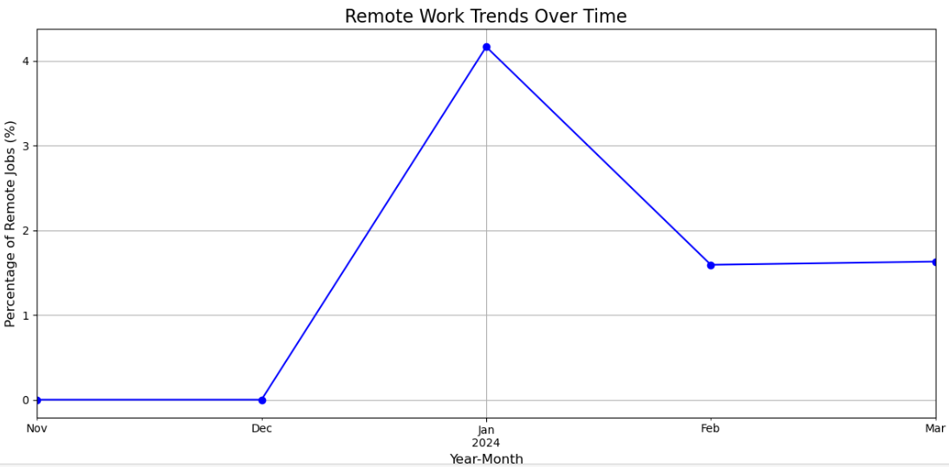
TASK 7 – REMOTE WORK LANDSCAPE ANALYSIS
Overall Interpretation:
The graph illustrates the relative demand for different job roles over a period spanning from December 2023 to March 2024. The demand for all roles appears to be very low until around February 1st, 2024, when there is a sharp increase. The demand for all roles remains high until the end of the observed period.
Possible Interpretations:
"Other" Role: The high demand for this category could be due to various factors such as emerging job roles, niche fields, or a broader definition that encompasses multiple professions.
Software Development: The consistent demand for software developers aligns with the ongoing technological advancements and the increasing reliance on software in various sectors.
Design, Content Writer, and Marketing: The growing importance of visual communication, digital marketing, and content creation across industries likely contributes to the increased demand for professionals in these areas.

Slide 16
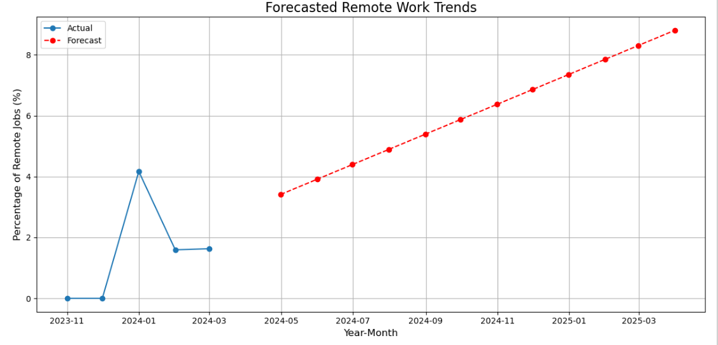
TASK 7 – REMOTE WORK LANDSCAPE ANALYSIS
FORCASTED REMOTE WORK TRENDS
Overall Interpretation:
The graph presents both actual and forecasted trends in the percentage of remote jobs over time, spanning from November 2023 to March 2025. The actual data shows a sharp increase in remote work followed by a decline, while the forecast predicts a continued and steady rise in remote work percentages.
Specific Observations:
Actual Data:
There's a significant spike in the percentage of remote jobs between November 2023 and January 2024. This is followed by a sharp decline in the percentage of remote jobs from January 2024 to February 2024. The percentage remains relatively stable from February 2024 onwards.
Forecast:
The forecast predicts a continuous and steady increase in the percentage of remote jobs from March 2024 onwards. The projected increase is more gradual compared to the initial spike in the actual data.
[109]:

Slide 17
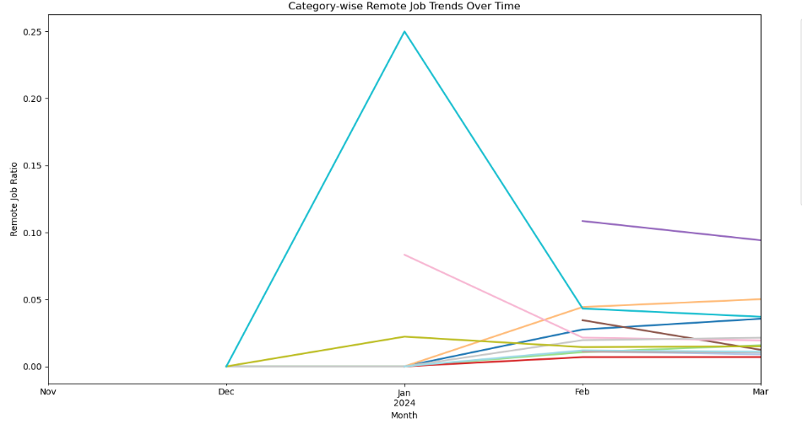
TASK 7 – REMOTE WORK LANDSCAPE ANALYSIS
TRENDS BY JOB CATEGORY
INTERPRETATION
The graph provides a snapshot of remote job trends across different categories. While the trends vary, the overall picture suggests a growing adoption of remote work, with some categories experiencing a more pronounced shift compared to others.

Slide 18
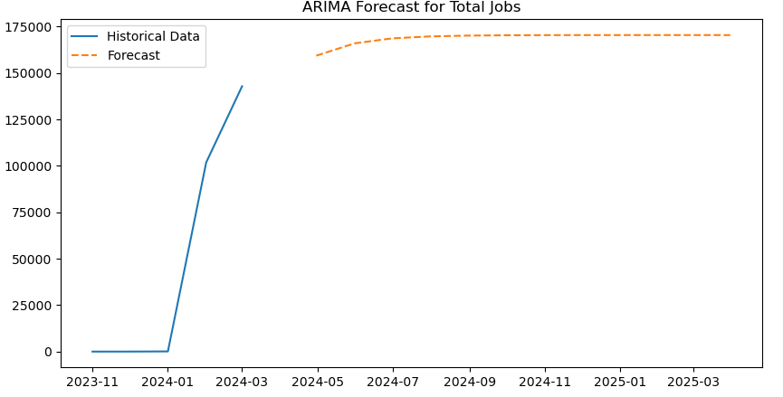
ARIMA FORCAST FOR TOTAL JOBS
INTERPRETATION
Historical Data: The historical data shows a relatively low number of total jobs until January 2024. There's a significant jump in February 2024, followed by a further increase in March 2024. This indicates a period of rapid job growth in the recent past.
Forecast: The forecast (orange dashed line) suggests a major increase in total jobs starting from April 2024. The growth rate appears to slow down slightly after the initial surge, but the overall trend remains upward, indicating continued job growth through March 2025.

Slide 19
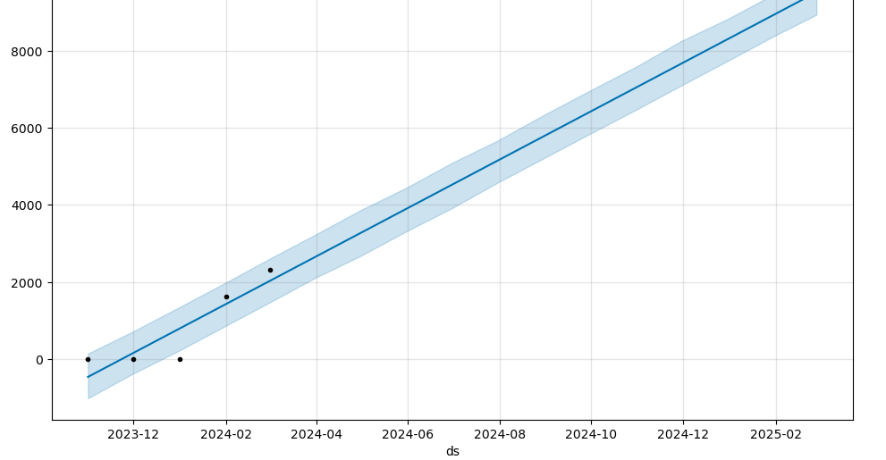
PROPHET FORECAST FOR REMOTE JOBS
Overall Interpretation:
This graph shows a forecast of remote job postings using the Prophet model, a time series forecasting tool developed by Facebook. The key takeaway is that the model predicts a continued upward trend in remote job postings, with both a clear upward trajectory (represented by the dark blue line) and a range of possible future values (the light blue shaded area).
Possible Interpretations:
Continued Growth of Remote Work: The forecast strongly suggests that the trend of increasing remote job opportunities will continue. This could be driven by factors like technological advancements, changing work preferences, and companies embracing remote work models for various benefits. Relatively Consistent Growth: The linear nature of the forecast suggests a steady and consistent increase, rather than explosive growth or decline. Uncertainty Increases with Time: The widening confidence interval is a natural feature of forecasting. It implies that the model is more certain about near-term predictions and less certain about long-term ones.

Slide 20
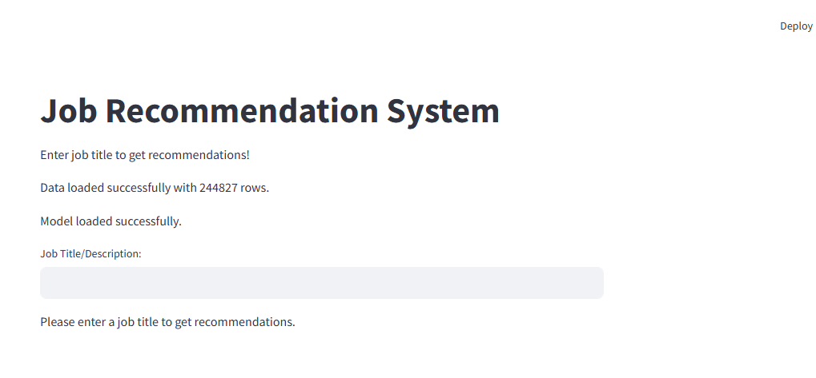
FINAL OUTPUT
This is how the final job recommendation system looks on execution of app.py file in streamlit.

Slide 21
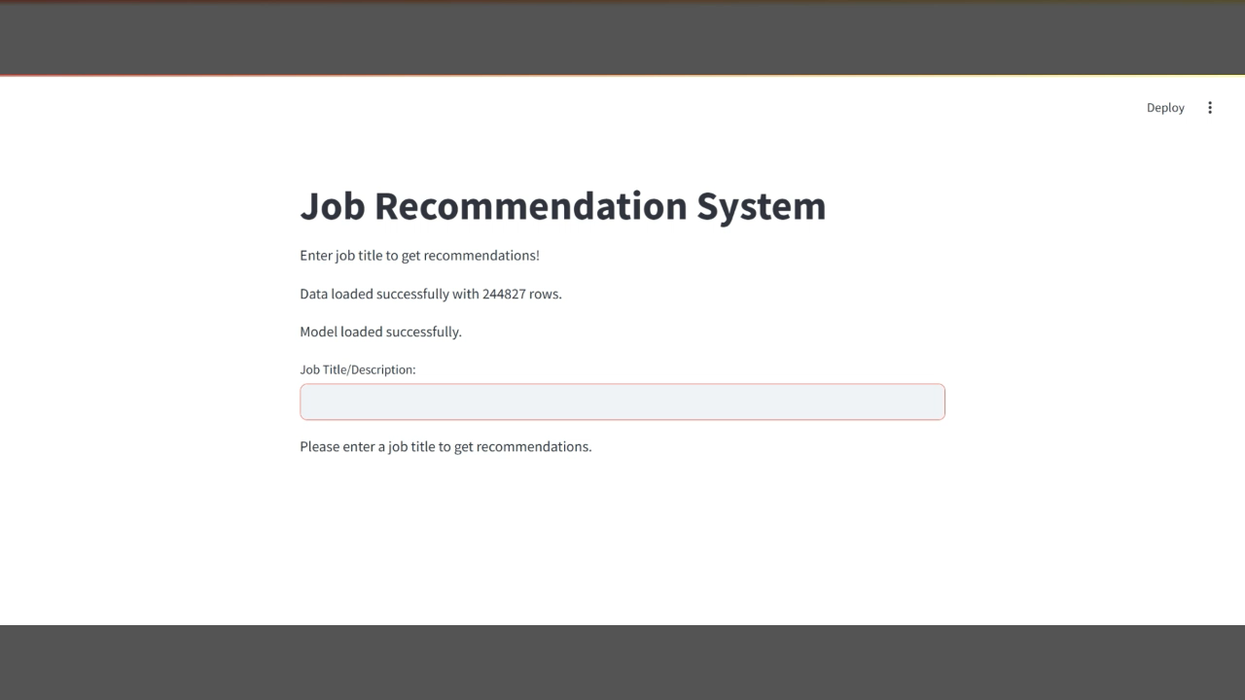
FINAL OUTPUT
This is a screen recording of the streamlit page while execution. Please press the play button to watch the video

Slide 22
THANK YOU

